Slide 1

MIT-WPU Final Year (B.Tech) System Software and Compiler Design

Slide 2
Module II
Macro processor: Macro Definition, Macro expansion and nested macros
Loaders: Loader schemes: Types of loaders, direct linking loaders.
Linkers: Relocation and linking concepts, self-relocating programs, Static and dynamic link libraries.

Slide 3
Loader

Slide 4
Loaders
Loader is a program that accepts the object program, prepares these programs for execution by the computer and initiates the execution of the program.
Functions of the loader
Allocate space in memory for the programs.(Allocation)
Resolve symbolic references between object decks.(Linking)
Adjust all addr dependent locations, such as addr constants, to correspond to the allocated space.(Relocation)
Physically place the m/c instr and data into memory.(Loading)
Programs loaded in memory
ready for execution
Program A
Program B
Program A
Loader
Program B
Databases

Slide 5
Concept of Relocation
Start 200
Add AREG S1
S1 DC 2
END
Start 300
Add AREG S1
S1 DC 2
END
Add AREG 201
S1 DC 2
300 Add AREG 201
301 S1 DC 2
301

Slide 6
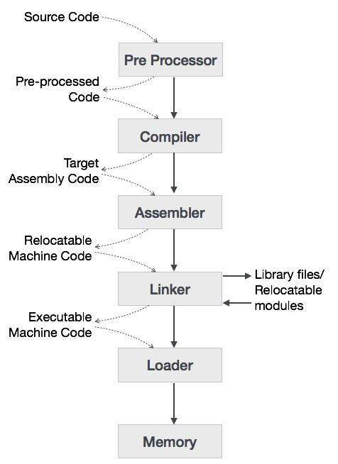
Language Processing System

Slide 7
Different Types of Loader Schemes
Compile and Go Loaders
General Loader Scheme
Absolute Loaders
Relocating Loaders
Direct Linking Loaders

Slide 8
1. Compile and Go Loaders
-Assembler places the code into core
-Loader consists of one instr that transfers to the starting instr of the newly assembled program
-easy to implement
-portion of memory is wasted because of assembler
-every time the program is run it has to be retranslated
-difficult to handle multiple segments
Memory
Program Loaded in memory
Assembler
Compile and go translator
Source Program

Slide 9
2. General Loader Scheme
As loader is smaller than assembler more memory is available
Reassembling of program is not required to run the program later.
Loader is present in memory.
Object Programs ready for execution
Loader
Source Program
Translator
Object Program 1
Loader
Source Program
Translator
Object Program 2

Slide 10
3. Absolute Loader
-Same as “compile and go “ loader except data is punched on cards instead of memory.
-Loader accepts m/c language text and places it into memory at the location specified by the assembler
Advantages
-More memory is available, -simple to implement
Disadvantages
-Programmer must specify address to the assembler where the program is loaded.
-In case of multiple subroutines, programmer has to remember address of each subroutine.
100
248
400
478
Main
Subroutine 1
Main
Absolute Loader
Subroutine 1

Slide 11
Relocating Loader (Binary Symbolic Subroutine)
-To avoid possible reassembling of all subroutines when a single subroutine is changed.
-To perform task of allocation and linking for the programmer.
-Allows many procedure segments but only one data segment.
-Translated code segments and the information regarding relocation and intersegment references is passed to the loader.
Information provided by the assembler to the BSS loader.
Transfer Vector
- Contains the address and names related to the subroutines referenced in the
program.
- Total length of the program
- length of transfer vector
Relocation Bits
- relocation bit is associated with every instruction
Relocation bits can be 0 or 1.
If 1 then address field needs relocation
If 0 then address field does not need relocation
ST 14 SAVE
ST 14 | SAVE
Relocation Bit=0 | Relocation Bit=1

Slide 12
4. Relocating Loader (Binary Symbolic Subroutine)
In BSS
All four functions of loader ( allocation, linking, relocation and loading )are performed automatically by the BSS loader.
Relocation bits are used to solve the problem of relocation.
The transfer vector is used to solve the problem of linking.
The program length information is used to solve the problem of allocation.

Slide 13
4. Relocating Loader (Contd..)
Source program Program Length = 48 bytes
Transfer Vector = 8 bytes
Rel. Rel Object Code
MAIN START Addr. Bits
EXTRN SQRT 0 00 ‘SQRT’
EXTRN ERR 4 00 ‘ERRb’
ST 14,SAVE 8 01 ST 14,36
L 1,=F’9’ 12 01 L 1,40
BAL 14,SQRT 16 01 BAL 14,0
C 1,=F’3’ 20 01 C 1,44
BNE ERR 24 01 BC 7,4 L 14,SAVE 28 01 L 14,36 BR 14 32 0 BCR 15,14
SAVE DS F 36 00 (Temp location)
END 40 00 9
44 00 3

Slide 14
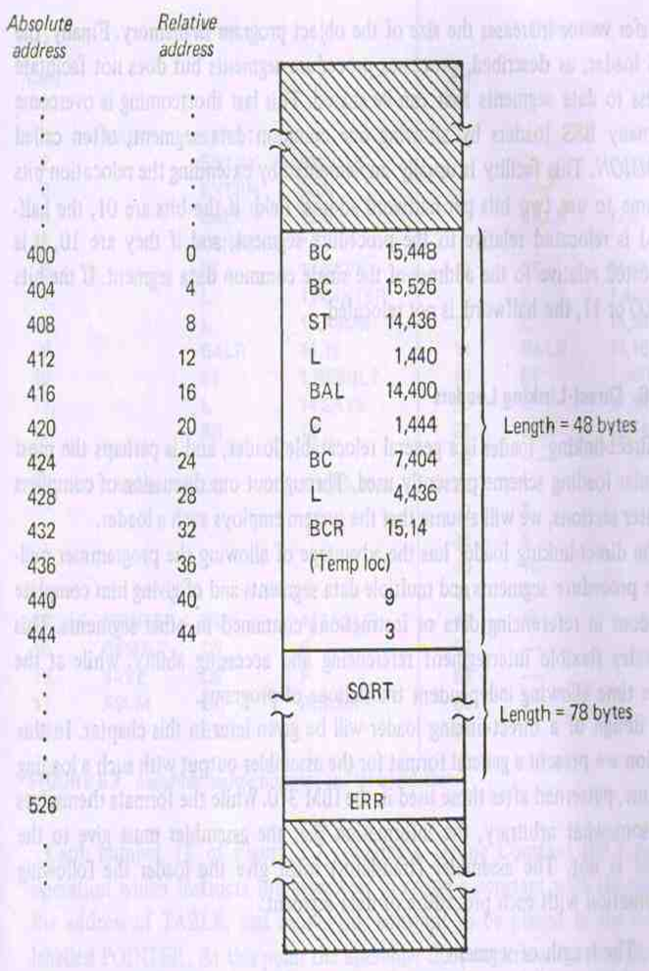
4. Relocating Loader (Contd..)
Transfer Vector

Slide 15
Disadvantages of Relocating Loader
The transfer vector linkage is only useful for transfers and not well suited for loading or storing external data.
The transfer vector increases the size of the object program in memory.
BSS loader processes procedure segments but does not facilitate access to data segments that can be shared.

Slide 16
5. Direct Linking Loader
Flexible intersegment referencing and accessing ability.
Allows independent translation of programs.
Information provided by the assembler with each procedure or data segment
Length of the segment.
List of symbols and relative locations.
List of symbols not defined but referenced.
Information where address constants are located.
M/c translation of source program and relative address assigned.
Assembler produces 4 types of cards in the object deck.
ESD 🡪 External Symbol Dictionary.
TXT 🡪 Actual Object Code.
RLD 🡪 Relocation and Linkage Directory.
END 🡪 End of object deck.

Slide 17
5. Direct Linking Loader(contd…)
ESD cards
Contains info related to all the symbols defined and referenced in the program.
Values for ESD cards are
SD ( Segment Definition) 🡪 name on START card
LD (Local Definition) 🡪 Specified on ENTRY card
ER (External Reference) 🡪 specified on EXTRN card
TXT cards
Contains actual object code translated version of program.
RLD cards
The location constant that needs to be changed due to relocation
By what is has to be changed
The operation to be performed(+/-)
END cards
End of object deck and specifies the starting address for execution if the assembled routine is the main program.

Slide 18
5. Direct Linking Loader(contd…)
Card No | ALP | Rel Loc | Translation
1. | JOHN START
2. | ENTRY RESULT
3. | EXTRN SUM
4. | BALR 12, 0 | 0 | BALR 12,0
5. | USING *, 12 |  | [12]<-- current value of LC
6 | ST 14, SAVE | 2 | ST 14, 54(0,12)
7. | L 1, POINTER | 6 | L 1, 46(0,12)
8. | L 15, ASUM | 10 | L 15, 58(0,12)
9. | BALR 14, 15 | 14 | BALR 14, 15
10. | ST 1, RESULT | 16 | ST 1, 50(0,12)
11. | L 14, SAVE | 20 | L 14, 54(0,12)
12. | BR 14 | 24 | BCR 15, 14
13. | TABLE DC F ’1, 7, 9, 10, 3’ | 28 32 36 40 44 | 1 7 9 10 3
14. | POINTER DC A(TABLE) | 48 | 28
15. | RESULT DS F | 52 | -
16. | SAVE DS F | 56 | -
17. | ASUM DC A(SUM) | 60 | ?
18. | END | 64
Offset + [index reg] + [base reg]
54 + 0 + [12] = 54 + 0 + 2 = 56

Slide 19
ESD And RLD Cards
ESD Cards
Ref No | Symbol | Type | Relative Loc | Length
1. | JOHN | SD | 0 | 64
2. | RESULT | LD | 52 | -
3. | SUM | ER | - | -
RLD Cards
Ref No | Symbol | Flag | Length | Rel Loc
14 | JOHN | + | 4 | 48
17 | SUM | + | 4 | 60

Slide 20
TXT Cards
TXT Cards
Ref No | Rel Loc | Object Code
4 | 0 | BALR 12,0
6 | 2 | ST 14, 54(0,12)
7 | 6 | L 1, 46(0,12)
8 | 10 | L 15, 58(0,12)
9 | 14 | BALR 14, 15
10 | 16 | ST 1, 50(0,12)
11 | 20 | L 14, 54(0,12)
12 | 24 | BCR 15, 14
13 | 28 | 1
13 | 32 | 7
13 | 36 | 9
13 | 40 | 10
13 | 44 | 3
14 | 48 | 28
17 | 60 | 0

Slide 21
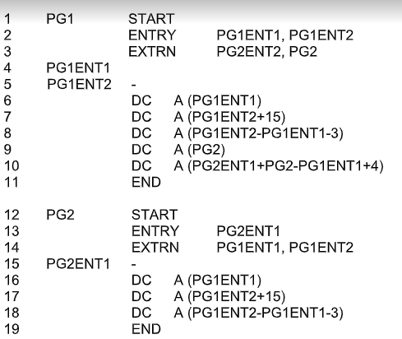

Slide 22
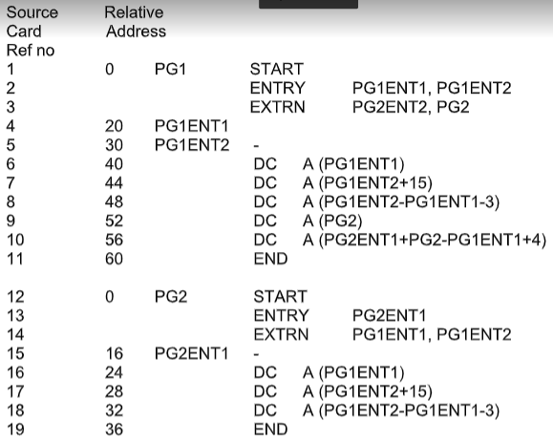

Slide 23
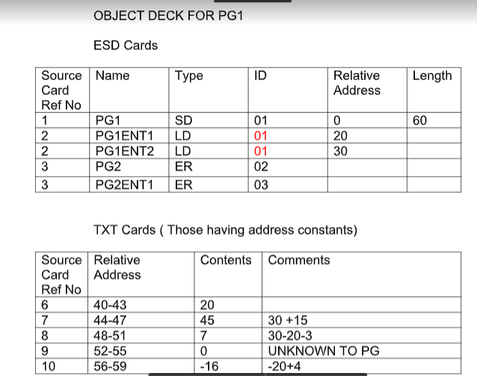

Slide 24
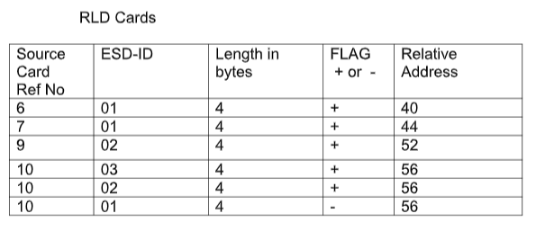

Slide 25
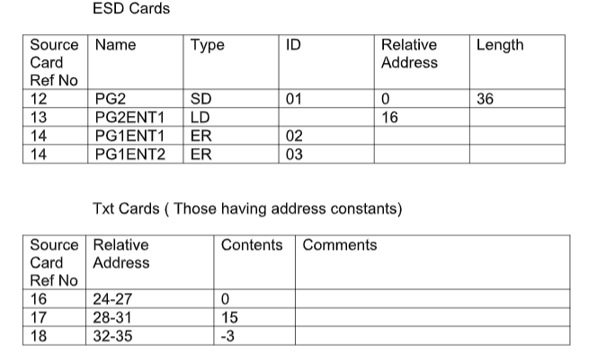
PG2

Slide 26
